Slide 1
Noninvasive Fibrosis Testing for Liver Disease
John Scott, MD, MSc, FIDSA
University of Washington
May 24, 2018

Slide 2
In the last year, I have served on a data adjudication cmte for Novartis on a non-Hep C and non-HIV medication. I serve on the AASLD guideline cmte and my talk today does not represent that cmte. Dr. Maggie Shuhart shared slides on FibroTest.

Slide 3
Objectives
To list the commonly used non-invasive tests for liver disease and their relative pros/cons
To describe how to resolve discrepancies in fibrosis scores

Slide 4
Case
You are seeing a 45 yo man with well-controlled HIV and untreated hep C. He has GT 1a, VL 800,000 IU/ml, plt count of 160, ALT of 45, AST 40 and otherwise nl liver panel. His only risk factor for Hep C is MSM intercourse and he tested positive for Hep C 10 yrs ago at time of HIV dx.
His APRI calculates to 0.625. His Fibrosure shows F4 fibrosis.

Slide 5
Case
What would you do next?
A) Take the highest score and use that for treatment and long term HCC surveillance decisions
B) Obtain a Fibroscan or liver biopsy
C) Obtain an ultrasound
D) Obtain an EGD

Slide 6
Overall Principles
Noninvasive tests perform best at extremes (F0, F4)
Most accurate when combined, especially with a different method
Be aware of limitations, including concurrent medications, conditions
Consider the clinical picture, such as duration of infection, synthetic labs, cytopenias, splenomegaly, physical exam
Fibroscan > Fibrosure > APRI
Look at the raw data!

Slide 7
Liver Biopsy is an Unreliable Gold Standard
Sampling error leads to misinterpretation in 10-15% of cases
Need at least 2 cm sample, >10 portal triads
Beware fracturing! Tipoff to cirrhosis
Can miss the diagnosis of cirrhosis
Invasive procedure with complications
Expensive ($2500)
Poor patient acceptance
Interpretation has significant inter observer variability
Seeff LB , et al. Clin Gastroenterol Hepatol . 2010;8:877–883. The French METAVIR Cooperative Study Group . Hepatology . 1994;20:15-20.

Slide 8
Benefits of Noninvasive Tests
Ease of administration
Lower cost (1/10th)
Assessment of degree of fibrosis
Assist with decision to treat or wait
Can be repeated over time to monitor progression of liver disease, need for long term HCC surveillance
May predict clinical outcomes better than liver biopsy

Slide 9
Indirect Markers of Fibrosis and Accuracy
Biomarkers | Cut-offs | Sensitivity | Specificity | Fibrosis
APRI | >0.7 >1.0 | 77% 61-76% | 72% 64-72% | ≥ F2 F3 or F4
FIB-4 | <1.45 >3.25 | 74% | 80% 98% | ≤F2 F4
Fibroindex | ≥ 2.25 | 36% | 97% | F2 or F3
Fibrosure | <0.31 >0.72 | NPV 91% PPV76% |  | <F2 ≥F2
For complete information Castera, L., Gastroenterology 2012;142: 1293-1302.

Slide 10
HCV Fibrosure/Fibrotest
Proprietary algorithm
Alpha 2 macroglobulin, GGT, haptoglobin, ALT, bilirubin, age, gender
4 approved US labs: Quest, LabCorp, Mayo and BioReference
Data submitted online to BioPredictive servers which vet for outliers, FP/FNs

Slide 11
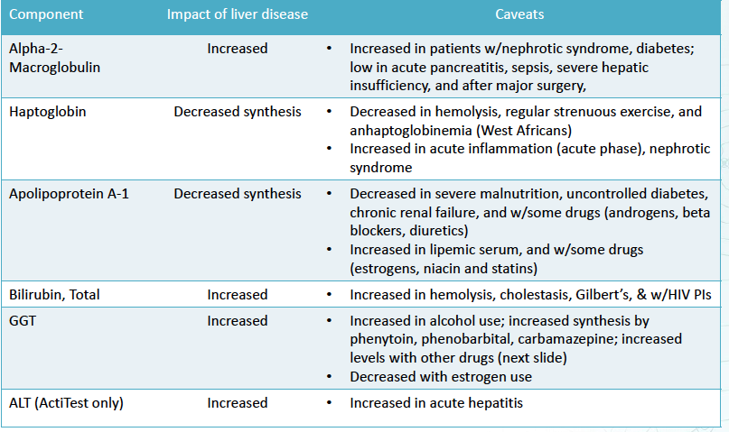
Factors Which Affect Fibrosure Interpretation
Source: Mayo Medical Labs

Slide 12
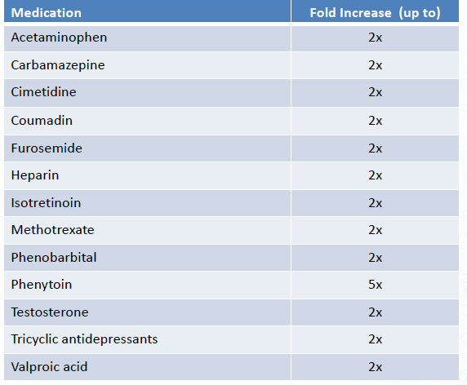
Medications that Increase GGT
Also:
Abx
NSAIDS
Antifungals
Anti-
depressants

Slide 13
FibroTest: Other Considerations
No need to fast!
Not accurate in acute hepatitis, hemolysis, extrahepatic cholestasis, acute inflammation (false neg)
Validated in renal txp patients, “acceptable” performance in ESRD pts
“As a general rule, extreme values in one of the 6 components should signal caution in interpretation
Haptoglobin < 12 mg/dl (43-212)
ALT >622 U/L
Bili >1.8 AND GGT < 50
Alpha 2 macroglobulin >590 mg/dL

Slide 14
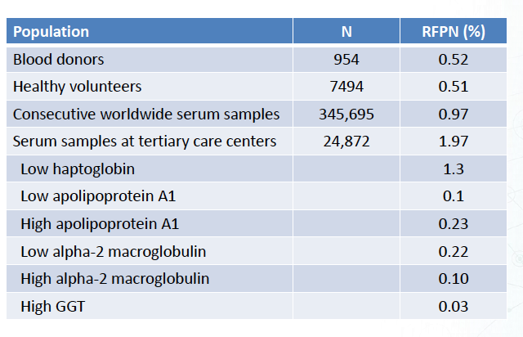
Risk of False Positive Negative (RFPN)
RFPN: Percentage of patients with abnormal component value for whom the switch to the component’s median value would induce a variation of Fibrotest result by at least 0.30 (=1.5 histological fibrosis stage)
Poynard T. BMC Gastro 2011; 11:39

Slide 15
Ultrasound
Can assess for nodularity of the liver surface
If present, >80% PPV
Coarseness of the parenchyma
Size of lymph nodes around the hepatic artery, patency and flow of veins and arteries, spleen size, hepatocellular carcinoma, and small volume ascites.
The use of high-frequency ultrasound transducers is reported to be more reliable than low-frequency ultrasound in diagnosing cirrhosis.

Slide 16
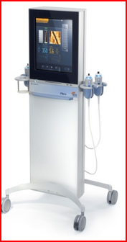
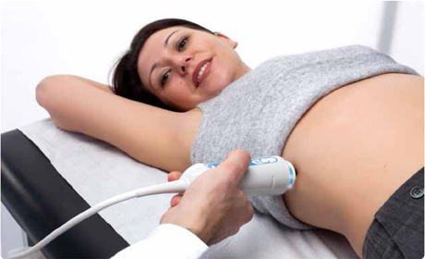
Fibroscan: How it Works

Slide 17
Fibroscan: Methods
Transient elastography examines a large mass of liver tissue (1 cm diameter by 5 cm in length) and thus provides a more representative assessment of the entire hepatic parenchyma.
Ultrasound transducer probe shoots sound wave toward hepatic tissue, the vibrations are followed by pulse echo and their velocities are measured, which is related directly to liver stiffness.
Patient should be fasting for at least 2 hrs.
Results limited in those with ascites, elevated central venous pressure, and obesity, as fluid and adipose tissue attenuate the echo waves.
Source: Castera L, et al. J Hepatol 2008; 48:835-47.

Slide 18
Fibroscan

Slide 19
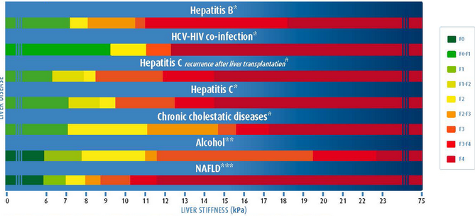
Different Cutoffs for Different Disease States

Slide 20
Transient Elastography Predicts Outcomes
N = 667 patients (HCV, 67%; nonalcoholic steatohepatitis, 13%) with liver disease (n = 120 with cirrhosis)
TE had an area under the receiver operating characteristic curve of 0.87 for predicting clinical outcome
High negative predictive value with liver stiffness of 10.5 kPa for excluding a liver-related clinical outcome such as variceal bleeding, liver failure, or development of HCC over 2 yrs
Outcomes with TE cutoff of 10.5 kPa, % | Sensitivity | Specificity | PPV | NPV
Overall population | 95 | 63 | 19 | 99
Cirrhotics only | 98 | 10 | 27 | 92
Klibansky DA, et al. J Viral Hepat . 2012;19:e184–e193.

Slide 21
Comparison of TE to Other Tests
AUROC for FS, FT, and APRI and Their Combinations, According to METAVIR Fibrosis Stages
Method | F ≥ 2 | F ≥ 3 | F = 4
Fibroscan (FS) | 0.83 | 0.90 | 0.95
Fibrotest (FT) | 0.85 | 0.90 | 0.87
APRI | 0.78 | 0.84 | 0.83
FS + APRI | 0.84 | 0.91 | 0.95
FS + Fibrotest | 0.88 | 0.95 | 0.95
FS + FT + APRI | 0.88 | 0.95 | 0.95
Castera L, et al. Gastroenterology 2005; 128:343-50.

Slide 22
Fibroscan: Cost and Logistics
CPT code 91200
Medicare reimburses $134.80 per test
HMC charges $250
Machine costs over $100,000
Available in most metropolitan areas now

Slide 23
References
Afdhal NH. Fibroscan (transient elastography) for the measurement of liver fibrosis. Gastroenterol Hepatol (N Y). 2012;8:605-7.
Castera L, Forns X, Alberti A. Non-invasive evaluation of liver fibrosis using transient elastography. J Hepatol. 2008;48:835-47.
Castera L, Vergniol J, Foucher J, et al. Prospective comparison of transient elastography, Fibrotest, APRI, and liver biopsy for the assessment of fibrosis in chronic hepatitis C. Gastroenterology. 2005;128:343-50.
Gara N, Zhao X, Kleiner DE, Liang TJ, Hoofnagle JH, Ghany MG. Discordance among transient elastography, aspartate aminotransferase to platelet ratio index, and histologic assessments of liver fibrosis in patients with chronic hepatitis C. Clin Gastroenterol Hepatol. 2013;11:303-8.
Kirk GD, Astemborski J, Mehta SH, et al. Assessment of liver fibrosis by transient elastography in persons with hepatitis C virus infection or HIV-hepatitis C virus coinfection. Clin Infect Dis. 2009;48:963-72.

Slide 24
Questions?

Slide 26
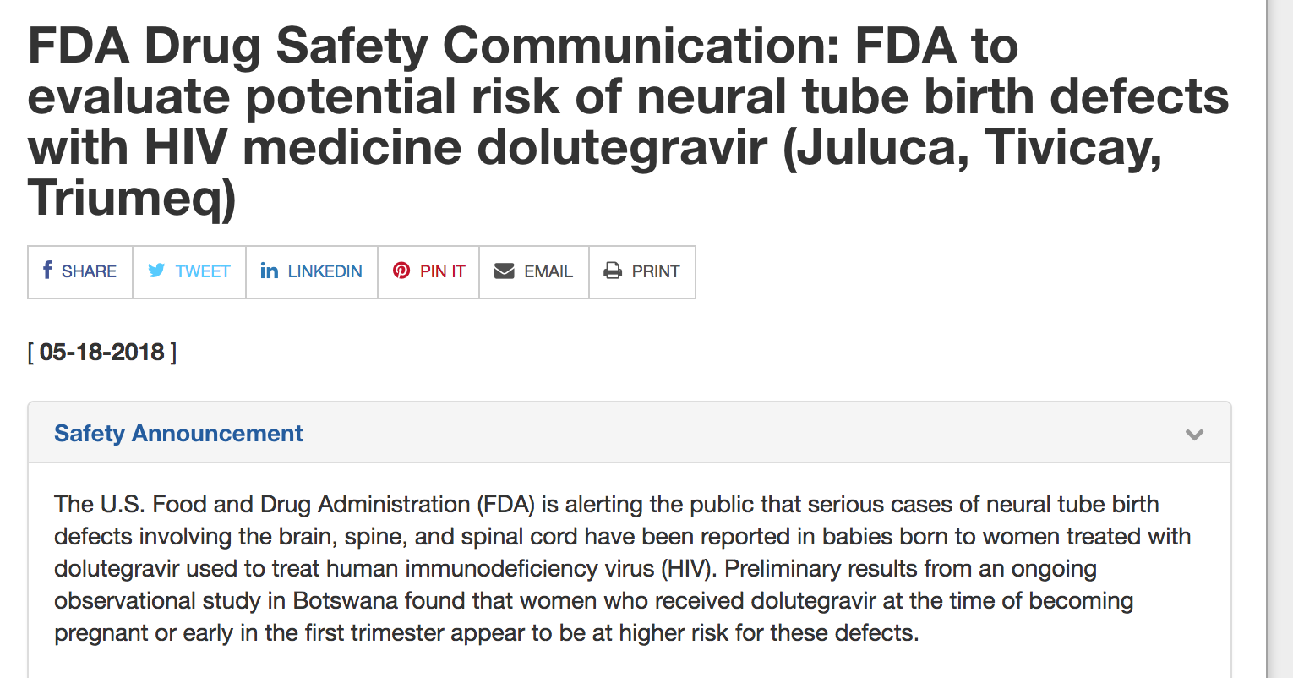

Slide 27
Data Behind the Warning
From DHHS:
Concern stems from a preliminary unscheduled analysis of an ongoing NIH-funded birth surveillance study in Botswana
4 cases of neural tube defects (NTD) out of 426 infants born to women who became pregnant while taking DTG
Rate of 0.9% compares to 0.1% among infants born to women taking non-DTG-based regimens at the time of conception
From the investigators:
No NTDs seen in nearly 3,000 women who started DTG during pregnancy (including nearly 300 who started in 1st trimester)

Slide 28
Conclusions
Conception while taking DTG may increase risk of NTD
Until we know more…
Women of child-bearing age taking NTD should use contraception
Women trying to become pregnant taking DTG should switch to an alternate regimen

